Slide 1

Veterans affairs voluntary services program
Viki Stripling
Department Hospital Chairman
Notes:
AI-generated content may be incorrect. --- This presentation provides a detailed overview of hospitals and the Voluntary Services Programs, including the Veterans Affairs Voluntary Service (VAVS). We will explore the historical development, significance, and contributions of these programs to the healthcare system.

Slide 2

Agenda Overview
Program Goal
Where You Can Volunteer
Why Volunteer
Types of Volunteers
Volunteer Activities
Volunteer Recruitment
HIPAA
Awards
Notes:
We will begin with an introduction to hospitals, covering their historical development, types, and essential functions. Next, we will discuss voluntary service programs within hospitals, including their definitions and impacts. Following that, we will dive deep into the Veterans Affairs Voluntary Service, exploring its objectives and volunteer roles. Finally, we will address the contributions of VAVS, the challenges faced, and future directions.

Slide 3

Primary goal of the hospital program
Improve Patient Care
Enhance Overall Healthcare Experience
Support the Medical Staff in Delivering High-Quality Services

Slide 4

Where can you volunteer?
Veteran Administration Hospitals
Veteran Administration Clinics
Non-VA Hospitals Caring for Veterans
Nursing Homes Serving Veterans
.
Notes:
Hospitals can be classified into various types, including general hospitals, specialty hospitals, teaching hospitals, and community hospitals. Each type serves specific patient needs and healthcare functions.

Slide 5

Why volunteer?
Motivate Patients With Activities
Provide Patient Support
Provide Companionship
Notes:
Hospitals provide a wide range of services, including emergency care, surgical procedures, maternal and child health services, and outpatient care. Understanding these functions highlights their critical role in health delivery.

Slide 6

TYPEs of volunteers
Anyone can volunteer:
Regularly Scheduled
Occasional Volunteers
Sponsored Volunteers
Student Volunteers

Slide 7
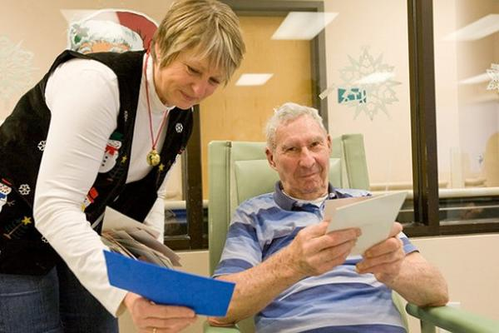
Volunteer activities
Reading
Painting
Playing Cards
Playing Games
Movie Day
Karaoke
Valentines For Veterans
Communicating and Listening to Stories
Honors Escort
Photo from Military.com

Slide 8

How to recruit volunteers
Emails and phone calls
Sign up sheets
Talk to your members & non-members (over the age of 14) get them involved
Find out what your volunteers’ interests are and plan accordingly to events coming up
Be sure to always recognize your Volunteers for a job well done

Slide 9

HIPPA
CONFIDENTIALITY: law requires volunteers to maintain the privacy and security of patient protected health information.
Volunteers must NEVER discuss or disclose any information they:
See
Read
Hear

Slide 10
awards

Slide 11
Department awards
1. Special Award to one VFW Auxiliary member in each of the 5 membership classes who recruits the most Hospital (VA and non-VA facilities) volunteers from July 1, 2025 to March 31, 2026.
Entry form required available on MALTA Member Resources. Citations to be mailed directly to winners from National Headquarters after the 2026 VFW Auxiliary National Convention.
2. Special Award for Hospital Volunteer Volunteer of the Year to one VFW Auxiliary member in the Department for Hospital (VA and non-VA facilities) volunteers from July 1, 2025 to March 31, 2026. Entry form requiredavailable on MALTA Member Resources. Plaque to be mailed directly to winner from National Headquarters after the 2026 VFW Auxiliary National Convention.
3. Special award for Most creative/unique activity and/or event to interact with and provide happiness to veterans in hospitals (VA and non-VA facilities) in each of the membership classes
Entry form is requiredand available in MALTA Member Resources. VFW Auxiliaries must send the required entry form to the Department Hospital Chairman by March 31, 2026 for judging. The Department Hospital Chairman must sign and send a copy of the completed Department winning entry form to the National Hospital Ambassador by April 30, 2026 for judging. Citations will be mailed directly to the winning VFW Auxiliaries from National Headquarters and money will be deposited into the winning VFW Auxiliary account after the 2026 VFW Auxiliary National Convention.

Slide 12
NATIONAL AWARDS AUXILIARY MEMBERS
1. Citation to one VFW Auxiliary member in each of the 10 Program Divisions who recruits the most Hospital (VA and non-VA facilities) volunteers from July 1, 2025 to March 31, 2026.
Entry form required available on MALTA Member Resources. Citations to be mailed directly to winners from National Headquarters after the 2026 VFW Auxiliary National Convention.
2. "Hospital Volunteer Recruiter of the Year” plaque awarded to one VFW Auxiliary member in the nation who recruits the most Hospital (VA and non-VA facilities) volunteers from July 1, 2025 to March 31, 2026. Entry form required available on MALTA Member Resources. Plaque to be mailed directly to winner from National Headquarters after the 2026 VFW Auxiliary National Convention.
3. Citation to the Outstanding Hospital Volunteer of the Year in each of the 10 Program Divisions. Entry form required available on MALTA Member Resources. Citations to be mailed directly to winners from National Headquarters after the 2026 VFW Auxiliary National Convention.

Slide 13
Awards for auxiliaries
1. Most creative/unique activity and/or event to interact with and provide happiness to veterans in hospitals (VA and non-VA facilities)
• Citation and $25 to one VFW Auxiliary in each of the 10 Program Divisions for the most creative/unique activity and/or event to interact with and provide happiness to veterans in hospitals (VA and non-VA facilities).
Entry form is required and available in MALTA Member Resources. VFW Auxiliaries must send the required entry form to the Department Hospital Chairman by March 31, 2026, for judging.
The Department Hospital Chairman must sign and send a copy of the completed Department winning entry form to the National Hospital Ambassador by April 30, 2026, for judging.
Citations will be mailed directly to the winning VFW Auxiliaries from National Headquarters and money will be deposited into the winning VFW Auxiliary account after the 2026 VFW Auxiliary National Convention.

Slide 14


Building Bridges For Our Veterans
Be The Lighthouse in Somebody’s Storm

